Slide 1

Professional Grooming
Presented By:-
PATEL SAPNA OM.

Slide 2
Table of Content
Introduction
Why is Professional Grooming Important?
Key Elements of Professional Grooming
Personal Hygiene
Dress Code – What to Wear?
Accessories and Appearance
Effective Body Language
Communication & Etiquette
Group Discussions (GD) Grooming
Common Mistakes to Avoid
Benefits of Good Grooming
Final Grooming Checklist
Conclusion

Slide 3
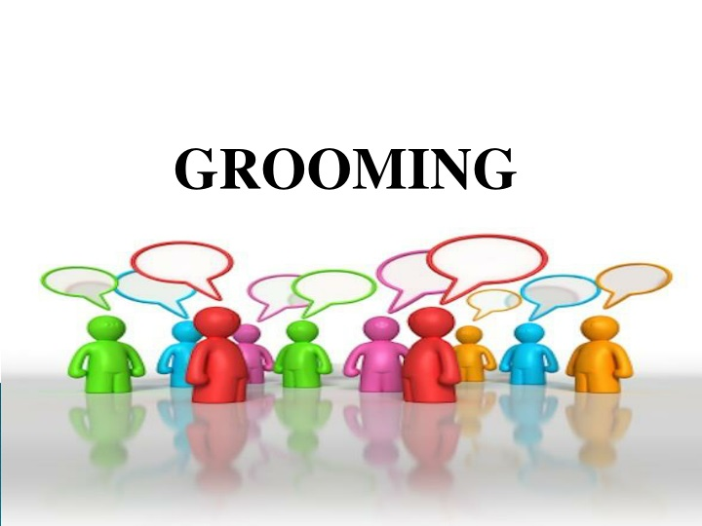
Introduction
Grooming and effective body language are essential components of making a positive impression in professional settings.
By focusing on grooming tips, appropriate attire, and mastering body language, individuals can enhance their confidence and improve perceptions during interviews and professional interactions.
"You never get a second chance to make a first impression.“
Professional grooming is about creating a lasting positive image.
It reflects your discipline, attitude, and readiness for the corporate world.

Slide 4
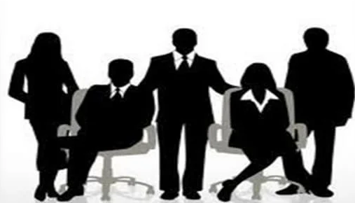
Why is Professional Grooming Important?
Creates positive first impressions.
Boosts self-confidence.
Increases chances of selection in interviews and group discussions.
Enhances professional credibility.
Helps you fit into corporate culture.
Maintaining a neat and clean appearance.
Presenting yourself with confidence and professionalism.
Developing positive body language.
Enhancing communication skills.

Slide 5
Key Elements of Professional Grooming
Category | Key Tips
Appearance | Dress appropriately, hygiene
Communication | Clear, respectful language
Body Language | Eye contact, posture
Etiquette | Politeness, punctuality

Slide 6
Personal Hygiene
Daily shower and use of deodorant.
Clean, trimmed nails.
Fresh breath and oral hygiene.
Well-groomed hair (neat style).
Ironed clothes and clean shoes.

Slide 7
Dress Code – What to Wear?
For Men | For Women
Formal shirt & trousers | Formal kurti, saree, or suit
Tie (optional but good) | Minimal, natural makeup
Polished formal shoes | Closed-toe formal shoes
Clean shave or trimmed beard | Simple jewelry
📝 Tip: Dress according to the company culture and job role.

Slide 8
Accessories and Appearance
Effective Body Language
Avoid loud or flashy accessories.
Keep hairstyles professional.
Wear a simple watch.
Light perfume-nothing overpowering.
Walk tall and confidently.
Confident posture.
Smile naturally.
Maintain appropriate eye contact.
Avoid nervous habits.
Firm handshake.
🔔 Remember: Actions speak louder than words!

Slide 9
Communication & Etiquette
Greet politely and professional (Good Morning/Afternoon).
Speak with clarity and confidence.
Listen actively without interrupting.
Thank the panel after the interview.
Keep your phone silent/off during interactions.

Slide 10
Group Discussions (GD) Grooming
Stay calm and composed.
Do not interrupt others.
Respect different opinions.
Be assertive, not aggressive.
Dress professionally-GD is also an assessment of personality.

Slide 11
Common Mistakes to Avoid
Overdressing or underdressing.
Poor hygiene.
Negative body language.
Interrupting the interviewer.
Overusing technical jargon.
Wearing wrinkled or casual clothes.
Using slang or informal language.
Overconfidence or arrogance.
Poor time management on test/interview day.
Ignoring small details (bad breath, unpolished shoes).

Slide 12
Benefits of Good Grooming
Increases your professional appeal.
Builds trust and respect.
Shows you value the opportunity.
Helps reduce nervousness-when you look good, you feel good!
Keeps you interview-ready anytime.
Creates a positive mindset.
Shows seriousness and preparation.
Boosts self-confidence during group discussions and interviews.
Improves overall performance.

Slide 13
Final Grooming Checklist
Clean, professional attire.
Polite greetings.
Positive body language.
Well-organized documents.
Calm and focused mindset.

Slide 14
Conclusion
Grooming is not just about looks; it's about attitude.
Professional grooming opens doors.
Be the best version of yourself, inside and out.
Professional grooming is not just about looks, it's about:
- Self-discipline.
- Respect for yourself and others.
- Being mentally, emotionally, and physically prepared for opportunities.
"Dress for the job you want, not the job you have."

Slide 15


